Slide 1
Plant leaf disease detection system
Sudeep Reddy.P(19BCE1018)
Durga Santosh(19BCE1664)
G.Tejith(19BCE1261)

Slide 2
Abstract
Plant disease is a huge challenge for farmers, which threatens their economy and food security. The rapid revolution in smartphone culture and computer vision models had created a great opportunity for image classification in agriculture. Convolutive neural networks (CNN) are considered to be at the cutting edge of image recognition technology and provide the capability to provide rapid and accurate diagnosis.In this document, the performance of a pre-formed ResNet34 model in the detection of crop diseases is investigated The developed model is deployed as a web application and is capable of recognising 7 plant diseases from healthy foliar tissues. For training and verifying the model, a dataset of 8,685 leaf pictures recorded in a controlled setting was created. The proposed method may obtain an accuracy of 97.2 percent and an F1 score of better than 96.5 percent, according to validation data. This proves CNNs' technical capability in diagnosing plant illnesses and paves the way for AI solutions for small-scale farmers.

Slide 3
INTRODUCTION
To meet expected demand by 2050, worldwide crop production must increase by at least 50% [1]. Currently, the majority of production takes place in Africa and Asia, where 83 percent of farmers are family-run and have little to no horticultural experience [2, 3]. As a result, yield losses of more than 50% are typical as a result of pests and illnesses
The old approach of human analysis by visual inspection is no longer viable for categorising agricultural diseases. Computer vision models provide a quick, standardised, and accurate answer to this problem. A classifier can also be used as an application once it has been trained [5]. All you need is an internet connection and a smartphone with a camera to use it. 'iNaturalist' [6] and 'PlantSnap' [7] are two popular commercial apps that show how this can be done. Both apps have been successful in not just providing users with expertise but also in creating an interactive online social network.
Smartphones are becoming more accessible and affordable every year. By 2020, the world's smartphone users will number around 5 billion [8]. One billion of these people live in India, and another one billion live in Africa. These figures have climbed every year for the last decade, according to Statista [9]. With these facts in mind, AI apps are expected to play a significant part in defining the future of agriculture.

Slide 4
Literature servey
in the paper ―Deep learning for Image-Based Plant detection” we proposed an approach to detect disease in plants by training a convolutional neural network. The CNN model is trained to identify healthy and diseased plants of some species. The model achieved an accuracy of 99.35% on test set data. When using the model on images procured from trusted online sources, the model achieves an accuracy of 31.4%, while this is better than a simple model of random selection, a more diverse set of training data can aid to increase the accuracy. Also some other variations of model or neural network training may yield higher accuracy, thus paving path for making plant disease detection easily available to everyone.in the paper ―Detection and Classification of leaf disease usingArtificial Neural Network” proposed an approach to detect diseases in plant utilizing the captured image of the diseased leaf. Artificial Neural Network (ANN) is trained by properly choosing feature values to distinguish diseased plants and healthy samples. The ANN model achieves an accuracy of 80%.

Slide 5
According to paper ―Detection of unhealthy region of plant leaves and classification of plant leaf diseases using texture features” , disease identification process includes four main steps as follows: first, a color transformation structure is taken for the input RGB image, and then by means of a specific threshold value, the green pixels are European Journal of Molecular & Clinical detected and uninvolved, which is followed by segmentation process, and for obtaining beneficial segments the texture statistics are computed. At last, classifier is used for the features that are extracted to classify the disease. in the paper ―Applying image processing technique to detect plant diseases” , a methodology for early and accurately plant diseases detection, using artificial neural network (ANN) and diverse image processing techniques. As the proposed approach is based on ANN classifier for classification and Gabor filter for feature extraction,it gives better results with a recognition rate of up to 91%.

Slide 6
In paper ―Plant disease detection using CNN and GAN” , an approach to detect plant disease using Generative Adversarial networks has been proposed.Background segmentation is used for ensuring proper feature extraction and output mapping.It is seen that using Gans may hold promise to classify diseases in plants, however.segmenting based on background did not improve accuracy.In the paper ―Convolutional Neural Network based Inception v3 Model for Animal Classification. have proposed use of inception v3 model in classifying animals in different species. Inception v3 can be used to classify objects as well as to categorize them, this capability of inception v3 makes it instrumental in various image classifiers.

Slide 7
PROPOSED METHOD
● Dataset Classification
● Building the CNN using transfer learning
● Training our Network
● Testing

Slide 8
Algorithm-(CNN)
A Convolutional Neural Network (ConvNet/CNN) is a Deep Learning algorithm which can take in an input image, assign importance (learnable weights and biases) to various aspects/objects in the image and be able to differentiate one from the other. The pre-processing required in a ConvNet is much lower as compared to other classification algorithms. While in primitive methods filters are hand-engineered, with enough training, ConvNets have the ability to learn these filters/characteristics.

Slide 9
Phase One – Trialling of Image size
Phase one will look into the impact of image size on model performance. A total of five image sizes ranging from 150 x 150 to 255 x 255 are evaluated.
To begin, download the Resnet34 pre-trained weights. All levels are frozen by default in transfer learning, with the exception of the final two layers. These include new weights and are tailored to the classification of plant diseases. Without backpropagating the gradients, freezing allows these layers to be being trained individually. The 1cycle policy is used to train the remaining layers in the same way.
The remaining layers are released once this is completed. A plot of learning rate vs loss is generated and analysed to facilitate the fine-tuning process. A suitable learning is chosen as a result, and the model is run. The model is re-created to the additional four image sizes after the results have been recorded . In each trial, all processes, including the learning rate, are repeated.

Slide 10
Phase Two – Model Optimisation
The ResNet34 model is optimised by using the most appropriate image size. Additional augmentation options have been added to the model to boost its performance even more (Fig. 2). Brightness changes (0.4,0.7) and warping are examples of operations (0.5).
The final two layers are segregated and trained at the default learning rate after that. After then, fine tuning is done by running several trials to test a variety of learning rates and epoch counts.

Slide 11
Phase Three – Feature Extraction
All of the data we collect in real life is in vast quantities. We'll need a method to decipher this data. It is not possible to process them manually. This is where the idea of feature extraction comes into play.
Feature extraction is a step in the dimensionality reduction process, which divides and reduces a large set of raw data into smaller groupings. As a result, processing will be simpler. The fact that these enormous data sets have a large number of variables is the most crucial feature. To process these variables, a large amount of computational power is required. As a result, feature extraction aids in the extraction of the best feature from large data sets by selecting and combining variables into features, effectively lowering the amount of data. These features are simple to use while still accurately and uniquely describing the real data set.

Slide 12
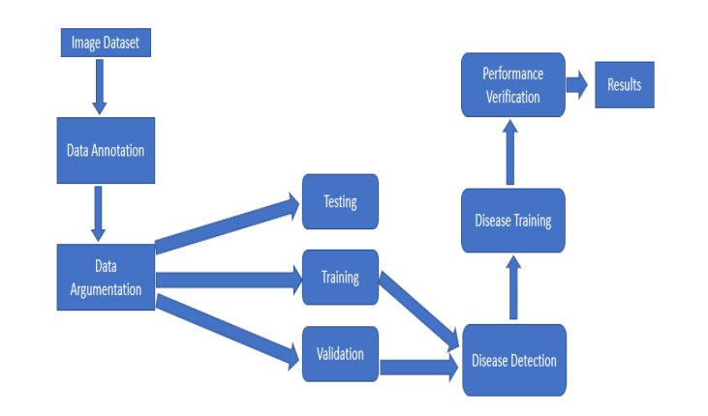
System overview

Slide 13
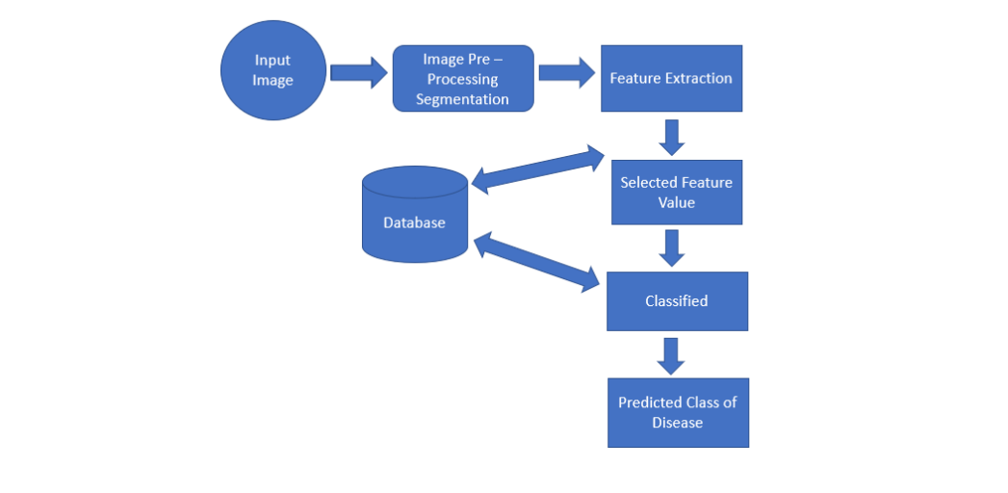

Slide 14
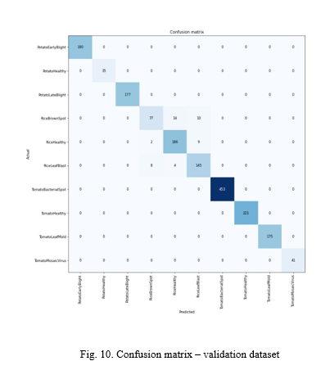

Slide 15
CONCLUSION
Crop protection in organic farming is a difficult undertaking. This requires a thorough understanding of the crop being farmed as well as potential pests, diseases, and weeds. A new deep learning model based on a special architectural convolution network has been constructed in our system to detect plant illnesses using photos of healthy or diseased plant leaves. The aforementioned system can be expanded to a real-time video entry system, allowing for unattended plant care. An intelligent system that treats diagnosed diseases is another feature that can be introduced to various systems. Plant disease management has been shown in studies to enhance yields by up to 50%.

